Slide 1

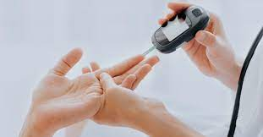
DIABETES PREDICTION
GROUP 8

Slide 2
CONTENTS
Background Information
What is an ES(Expert System)
Problem Statement
Data pre-pocessing steps
Model development
Conclusion

Slide 3

WHAT IS DIABETES?
Diabetes is a disease that occurs when your blood glucose/blood sugar is too high.
Blood glucose is our main source of energy and comes from the food we eat.
Insulin, a hormone made by the pancreas, helps glucose from food get into your cells to be used for energy.
Sometimes your body does not make enough—or any—insulin or does not use insulin well. Glucose then stays in your blood and does not reach your cells.

Slide 4
MAJOR TYPES OF DIABETES
When the body does not make insulin
TYPE 1
TYPE 2
When the body does not make enough insulin
Develops in some women when they are pregnant
GESTATIONAL

Slide 5
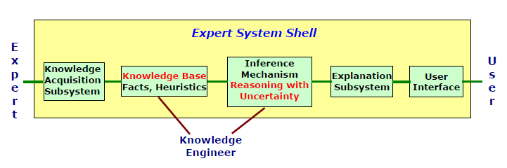
COMPONENTS OF AN EXPERT SYSTEM SHELL

Slide 6

PROBLEM STATEMENT
Diabetes is a common, chronic disease that dramatically increases the risk of various cardiovascular problems.
If you have diabetes, you are more likely to have heart disease or stroke. Hence, the prediction of diabetes at an early stage is very essential as it can lead to improved treatment.
The aim of this project is to develop an application that can quickly and efficiently determine if a person has diabetes.
This application system is backed up with data that has been analysed using an effective machine learning model.

Slide 7
This dataset is originally from the National Institute of Diabetes and Digestive and Kidney Diseases and it was downloaded from Kaggle.
It consists of 768 instances and 8 attributes. Out of the 768 instances, 268 are diabetic and 500 are non-diabetic and are described as 1 and 0 respectively in the target attribute (Outcome).
In this database, all patients are females of the Pima Indian heriatge and are of age at least 21 years. Attributes in the database are either integers or real numbers.
DATA DESCRIPTION
Pregnancies: The number of times the person was pregnant
DATA ATTRIBUTES
Glucose: Plasma glucose concentration
Blood Pressure: Diastolic blood pressure (mm Hg)
SkinThickness: Triceps skin fold thickness (mm)
Insulin: 2-Hour serum insulin (mu U/ml)
BMI: Body mass index (weight in kg/(height in m)²)
DiabetesPedigreeFunction: Diabetes pedigree function
Age: Age (years)
Class variable: (0-no diabetes, 1-has diabetes

Slide 8

DATA PRE-PROCESSING
Data pre-processing includes all necessary steps to transform the dataset into a format that is acceptable by the machine model that will be built.
This could include missing value detection and imputation or removal, outlier detection, or scaling the variables.

Slide 9
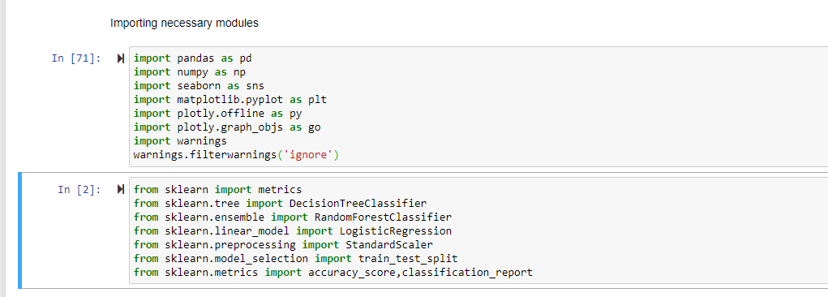
1. Importing Libraries

Slide 10
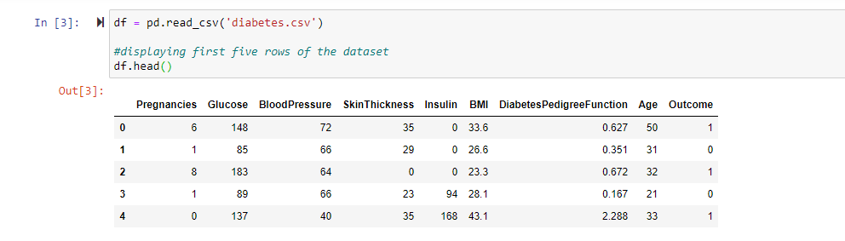
2. Loading the Data

Slide 11
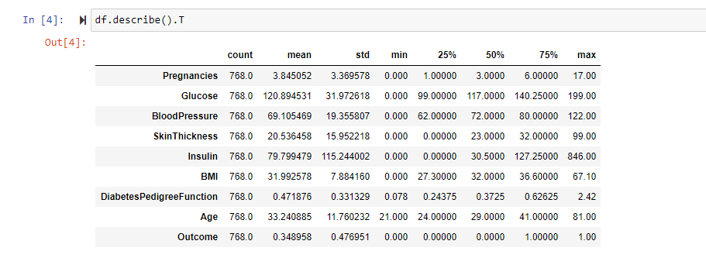
3. Describing the Data

Slide 12
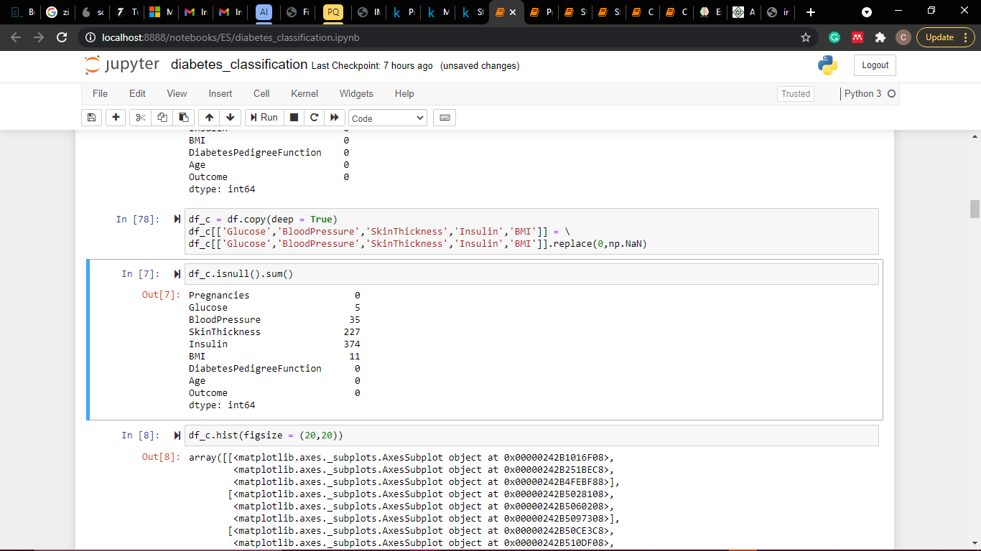
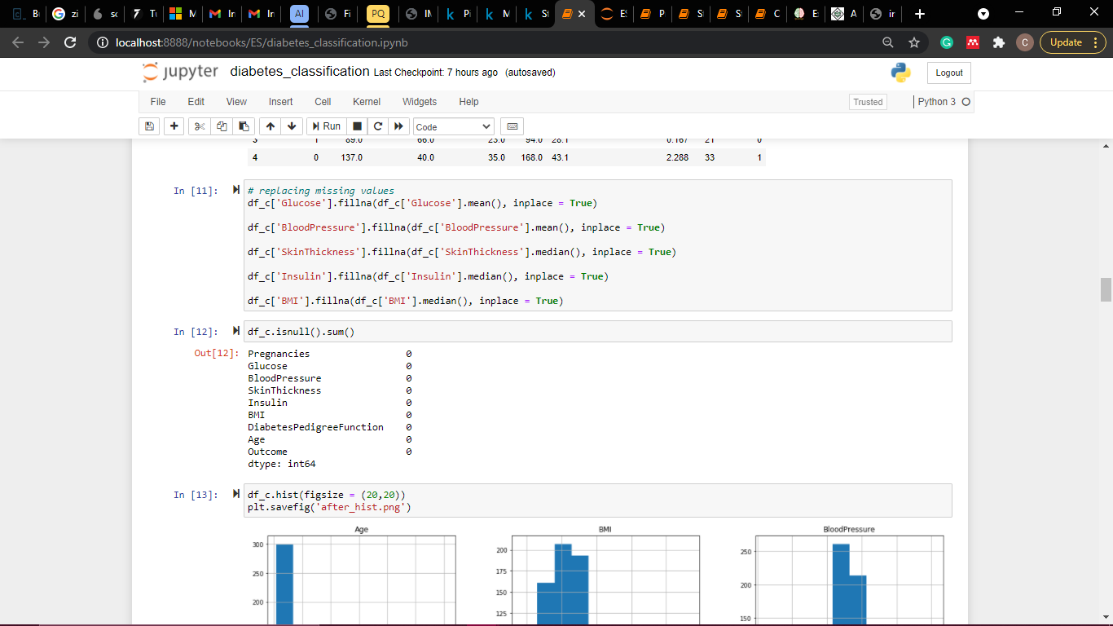
4. Missing value imputation

Slide 13
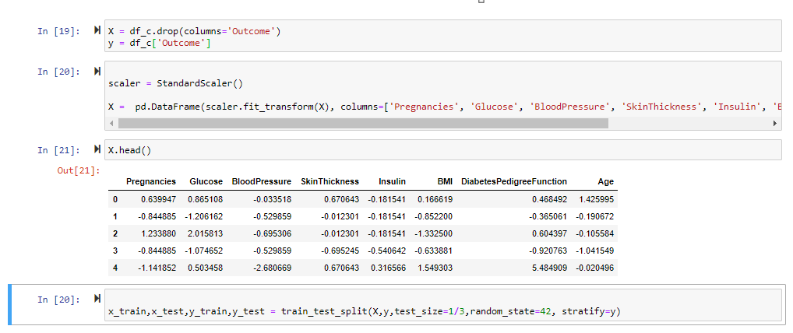
5. Scaling the data

Slide 14
EXPLORATORY DATA ANALYSIS (EDA)
Exploratory Data Analysis refers to the process of performing initial investigations on data to discover patterns, to spot anomalies, to test hypothesis and to check assumptions with the help of summary statistics and graphical representations.
It is a good practice to understand the data first and try to gather insights from it. EDA is all about making sense of data in hand, before building the model. EDA was carried out using three visualization tools.

Slide 15
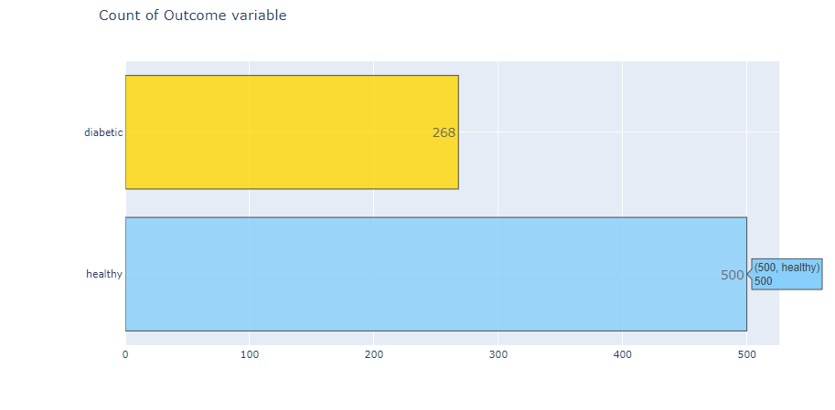
Bar Chart

Slide 16
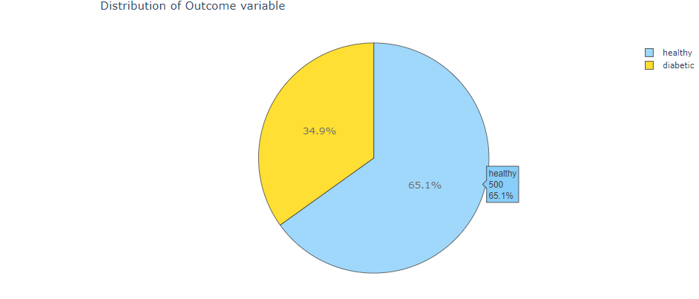
Pie Chart

Slide 17
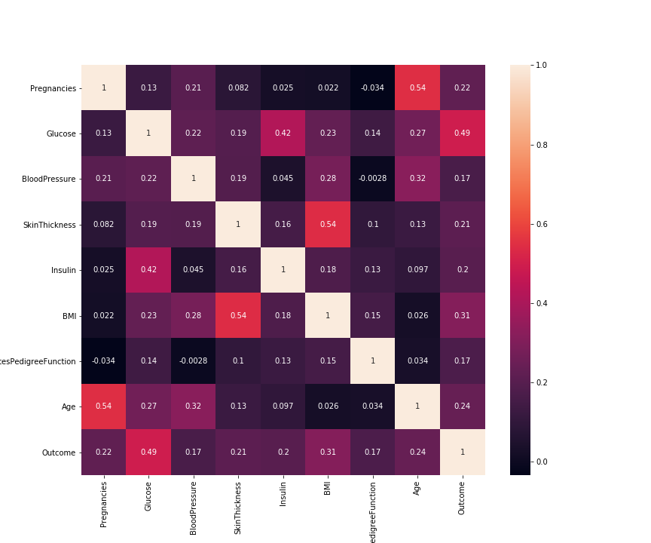
Correlation Matrix

Slide 18
Algorithms Used

Slide 19
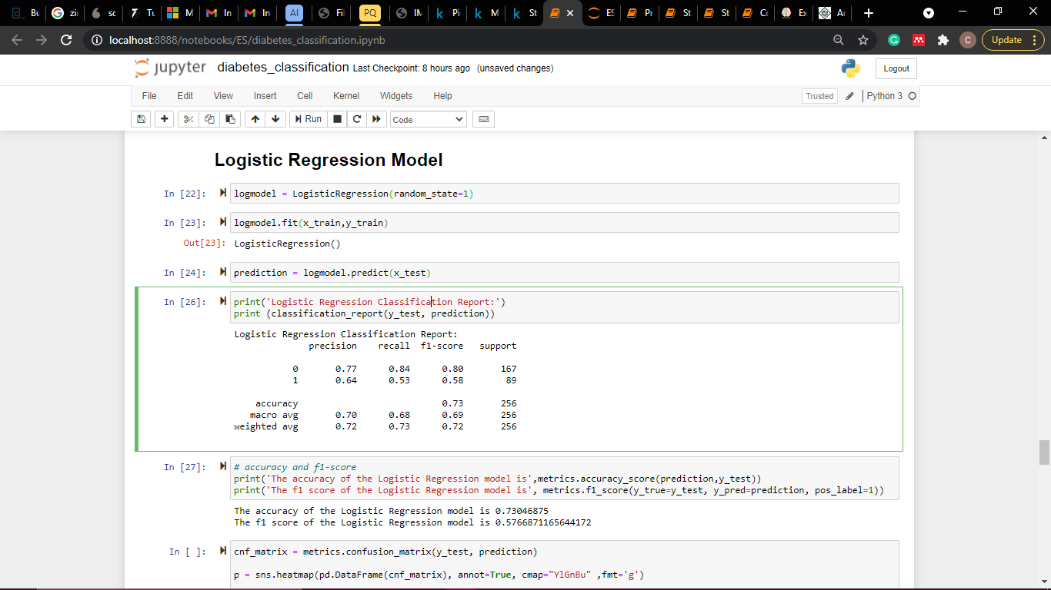
Logistic Regression

Slide 20
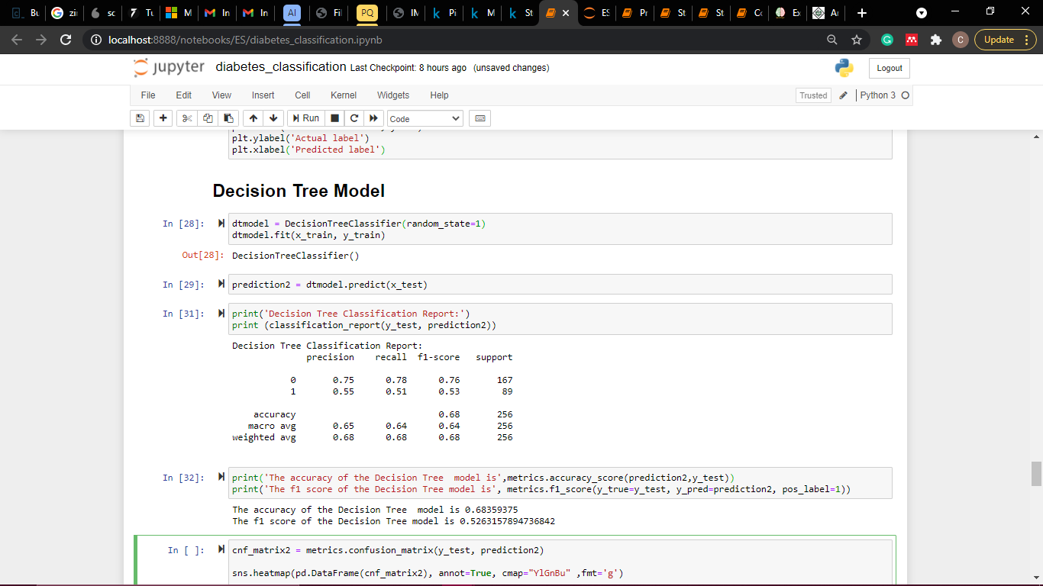
Decision Tree

Slide 21
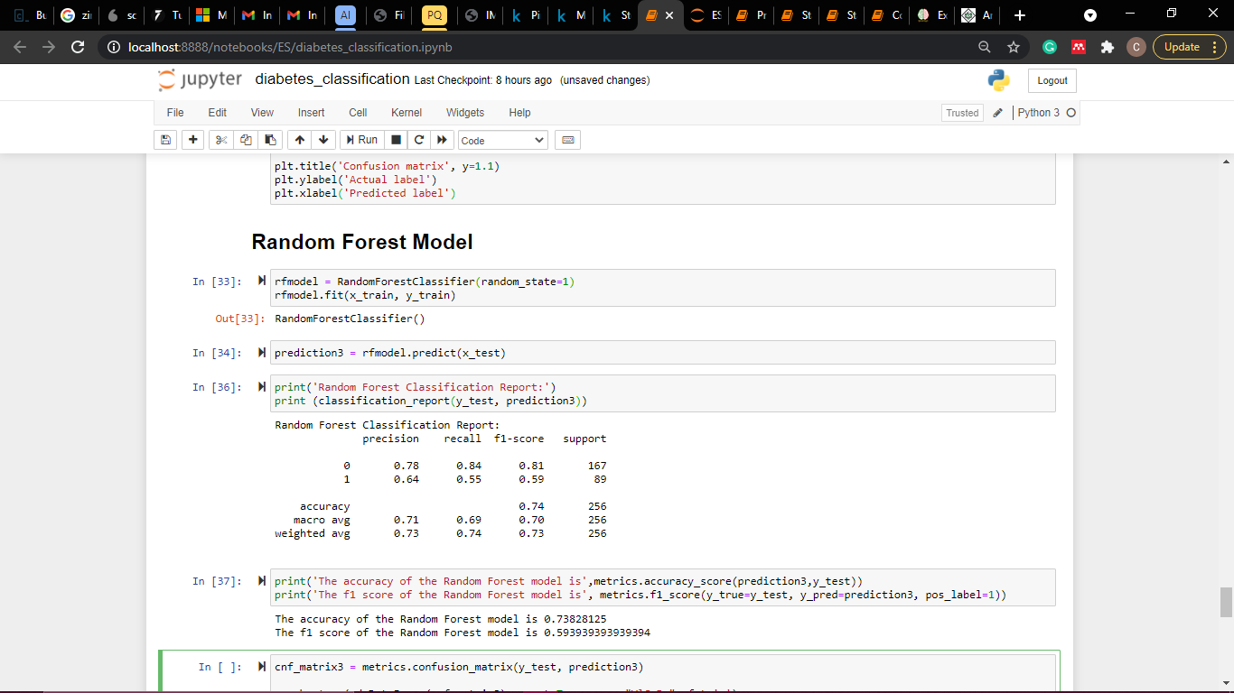
Random Forest

Slide 22
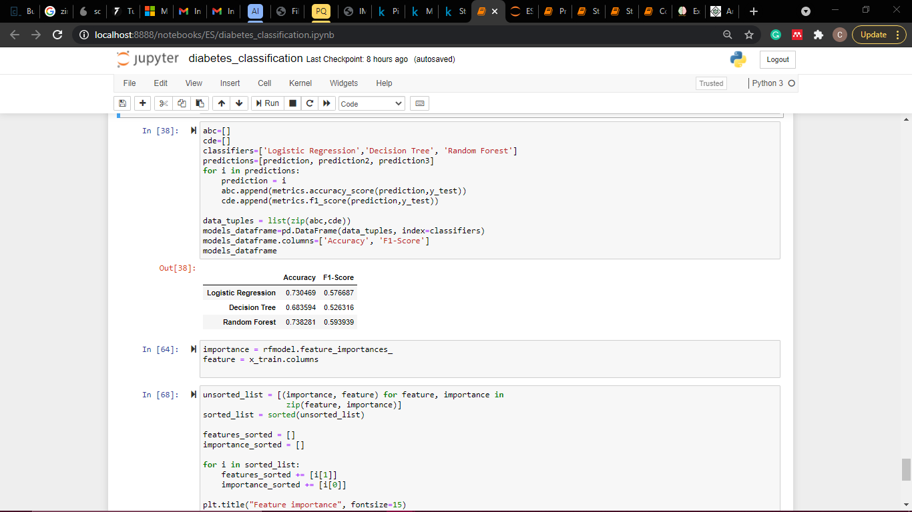

Slide 23
Building the Expert System

Slide 24
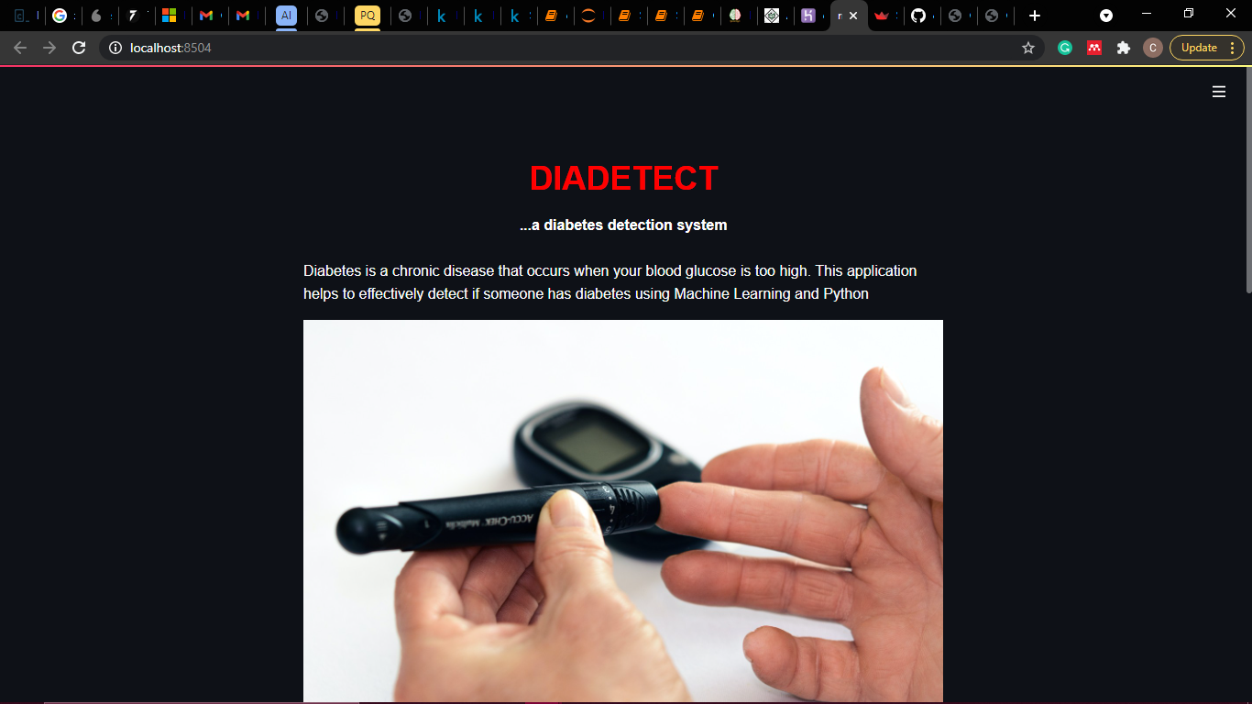

Slide 25
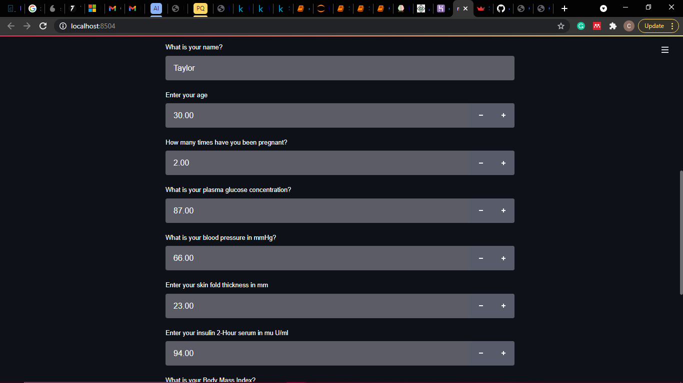

Slide 26
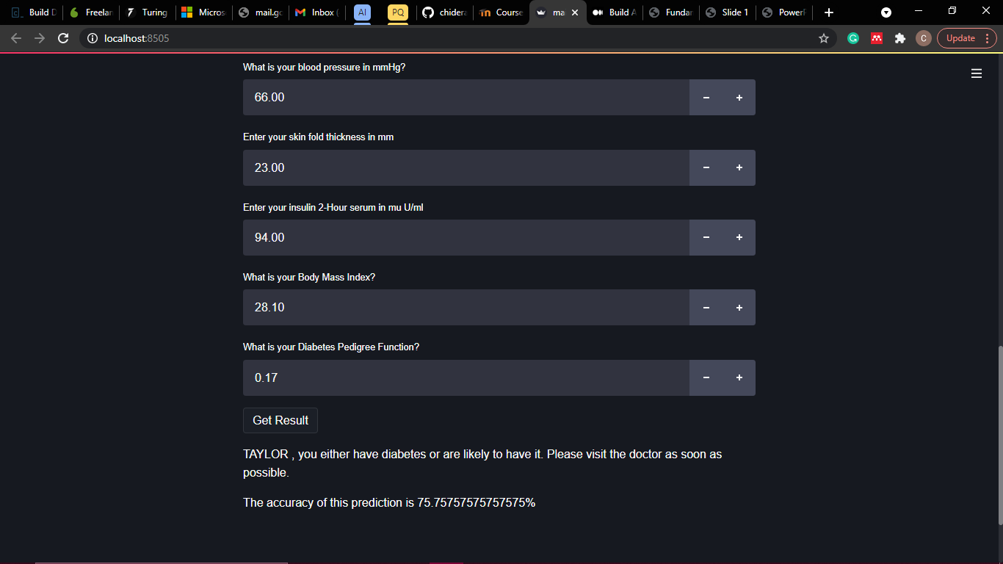

Slide 27
Conclusion
The aim of this project was to build a model that can accurately predict if an individual has diabetes or not. Three different models were built: Logistic Regression, Decision Tree, and Random Forest. The Random Forest classifier gave the best model, so it served as the inference engine for the expert system.
The variables of the Random Forest model were analysed, and the most significant variables were glucose, BMI, age, and diabetes pedigree function. This corresponds to the most correlated variables as seen in the correlation matrix above.

Slide 28
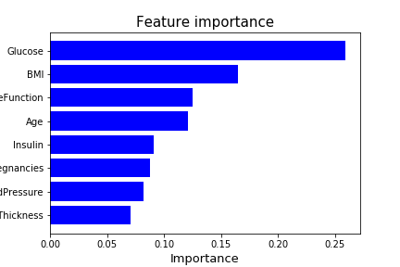

Slide 29
THANK YOU!

Slide 30
GROUP MEMBERS
TAIWO ADEBOLA TEMITOPE-GROUP LEAD (17CG023222)
LIADI AKOREDE MUEEZ (17CG023184)
ANI CHIDERA PRISCILLA (17CG023150)
KEKEOCHA GLORY NDUMBUCHI (17CH023258)
ANENE NMESONMA (17CH023244)
EKWUNIFE BLESSING (17CD023304)

